Slide 1

Pension Management System
By Piyush Ramteke

Slide 2
Introduction:
This is a fully computerized system. It is a web-based software application that creates an online case record for each retiree, calculates their individual tip and pension.
All of this happens at the touch of a button. The Pension Management System offers a great advancement in paying monthly payments.
The system creates daily reports and tracks the progress of pension payments and distribution.

Slide 3
Abstract:
There are two type of users are Admin and user. Only Admin can edit and create the applicants and user only view the data.
User applicant have either active or retired employee status.
Retired employee can withdraw their pension amount and active employee cannot withdraw pension.
Admin handel all the databases and if required admin can change.

Slide 4






Requirements:
Java JDK
Spring Boot Framework
Maven Tool
Postman
MySql
Docker

Slide 5
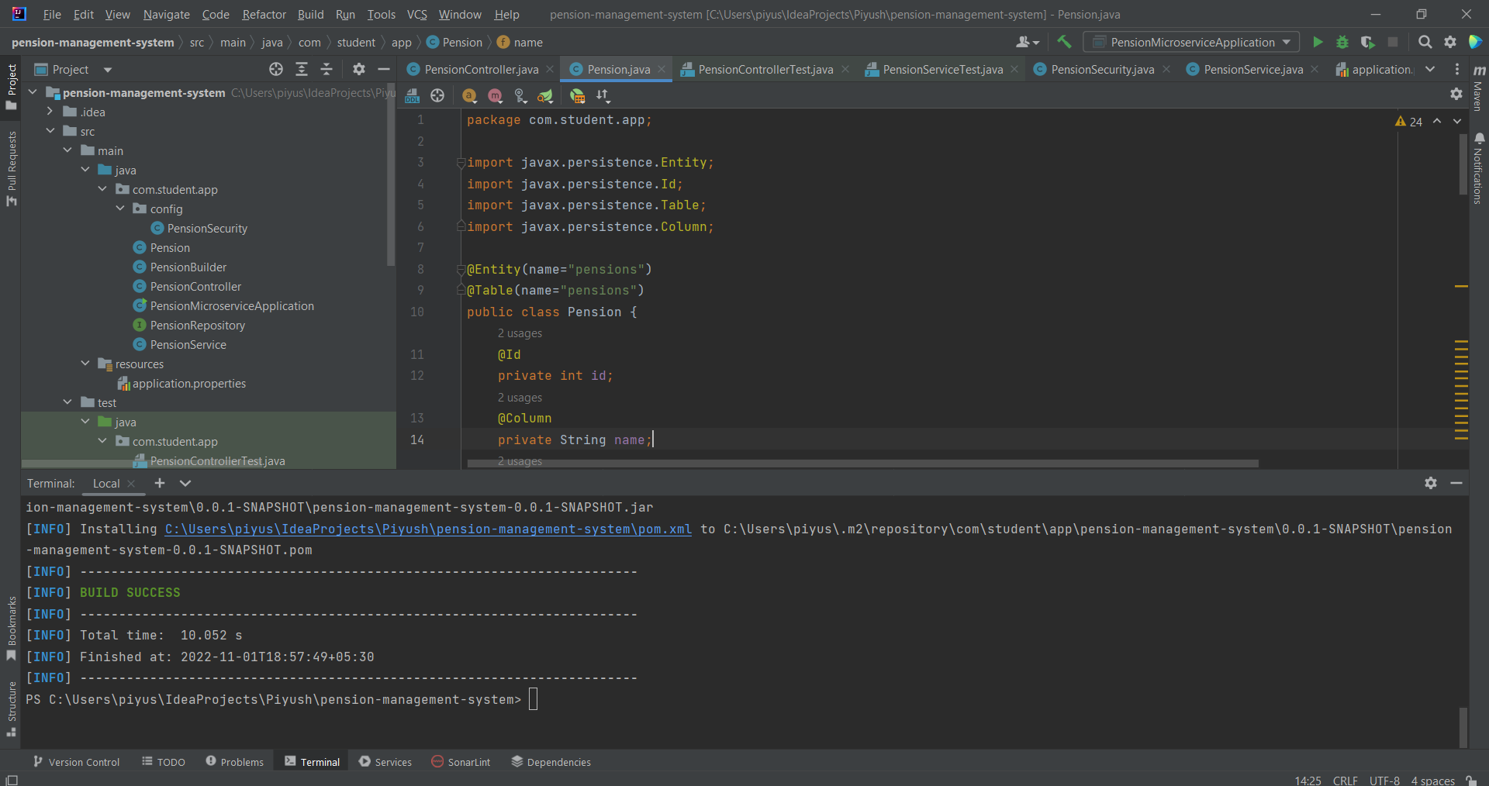
MVN Clean Install:

Slide 6
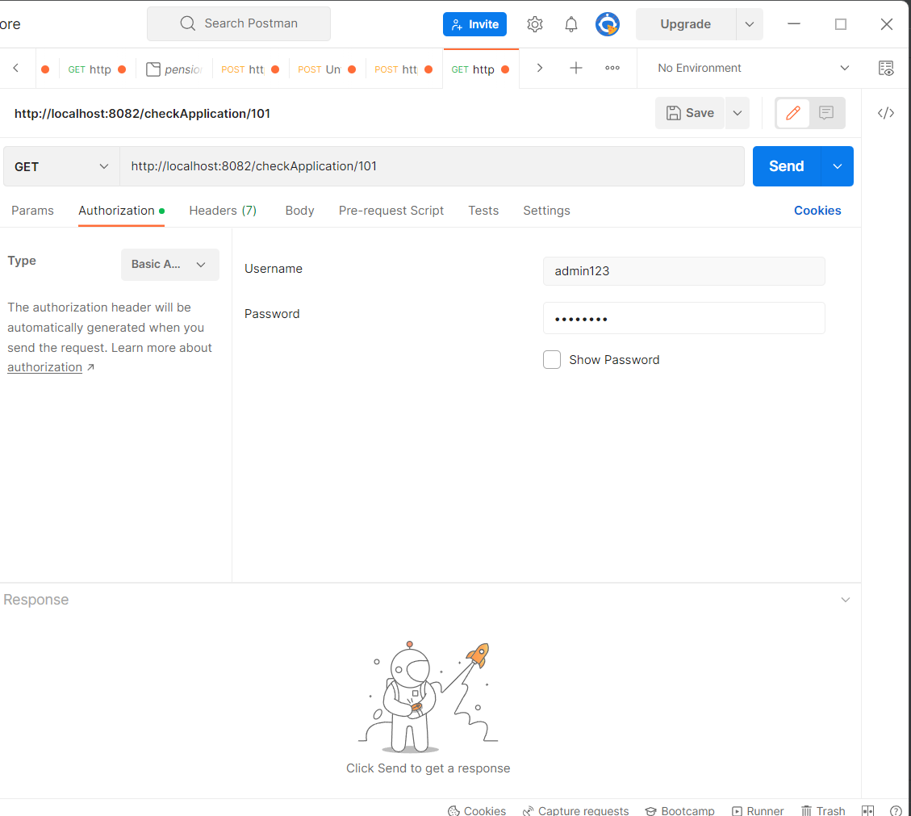
Application Authentication:

Slide 7
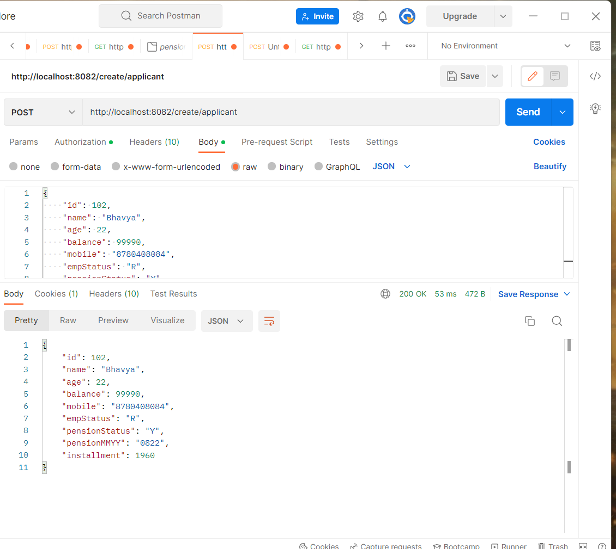
Create New Applicant:

Slide 8
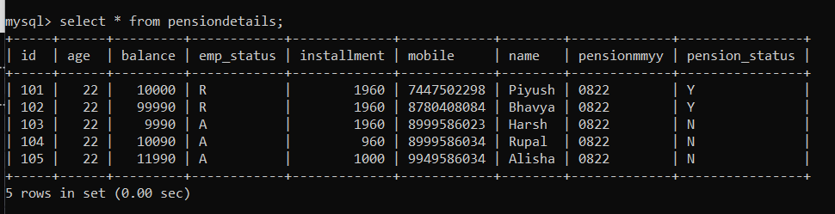
MySql Database:

Slide 9
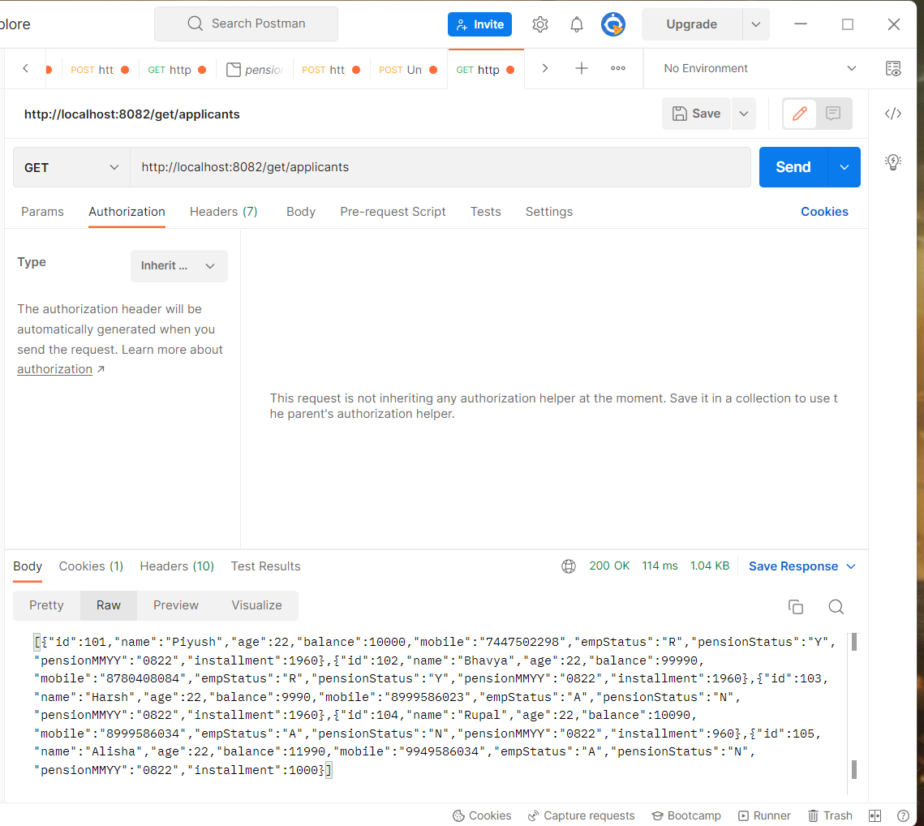
Get All Applicant:

Slide 10
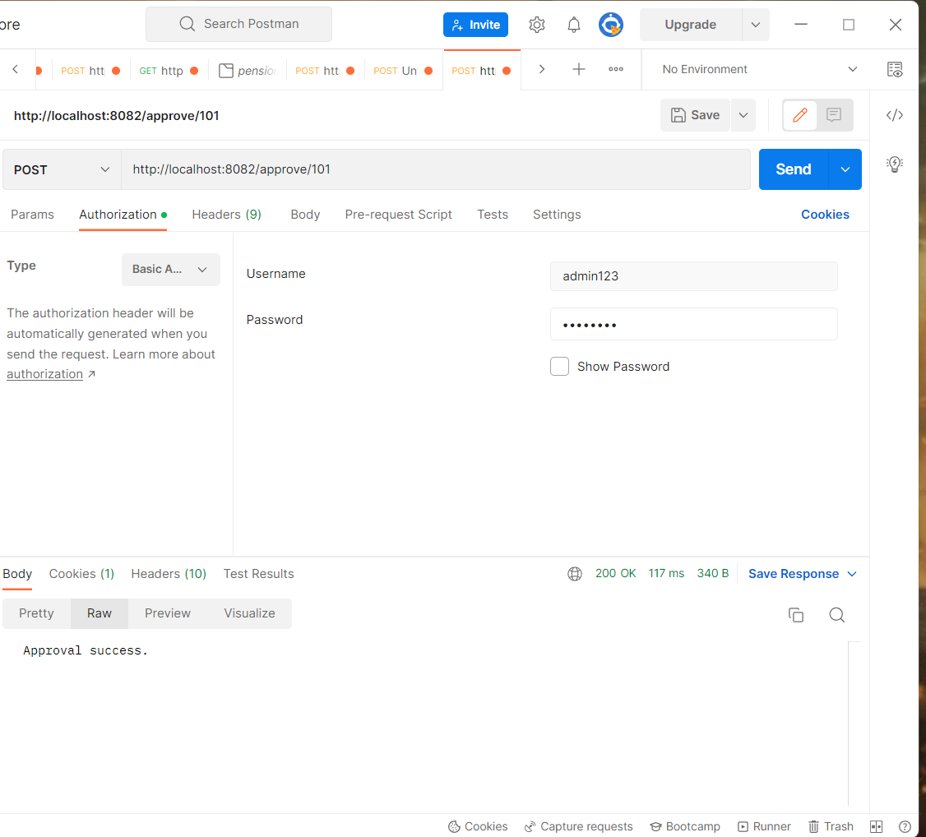
Approval By Admin(Employee Status: R):

Slide 11
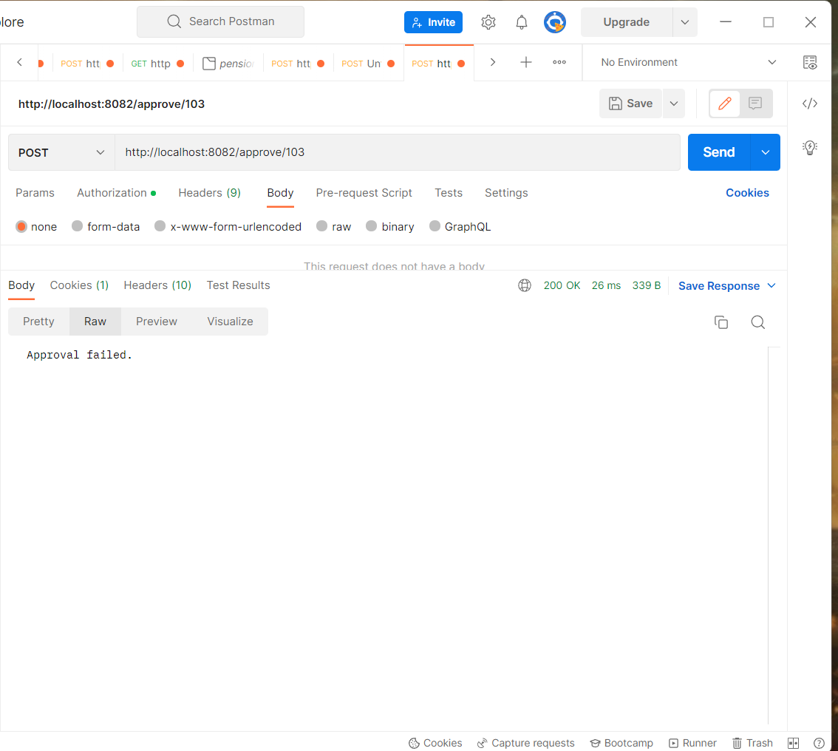
Approval By Admin(Employee Status: A):

Slide 12
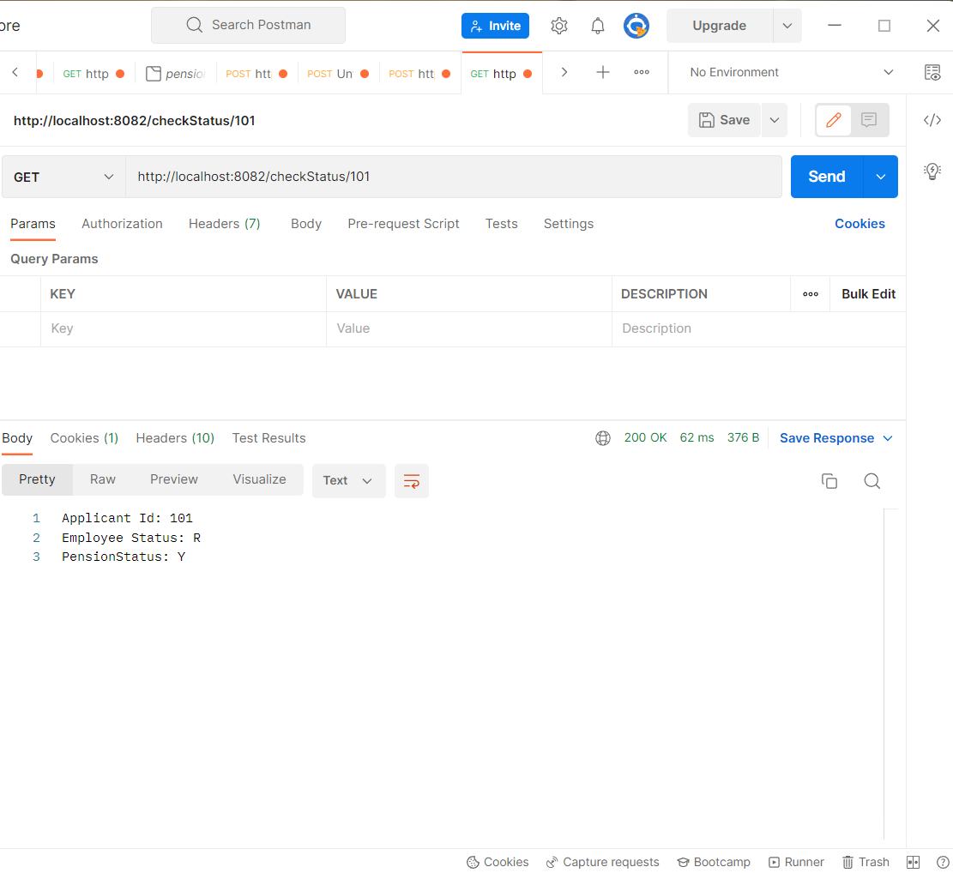
Check Status:

Slide 13
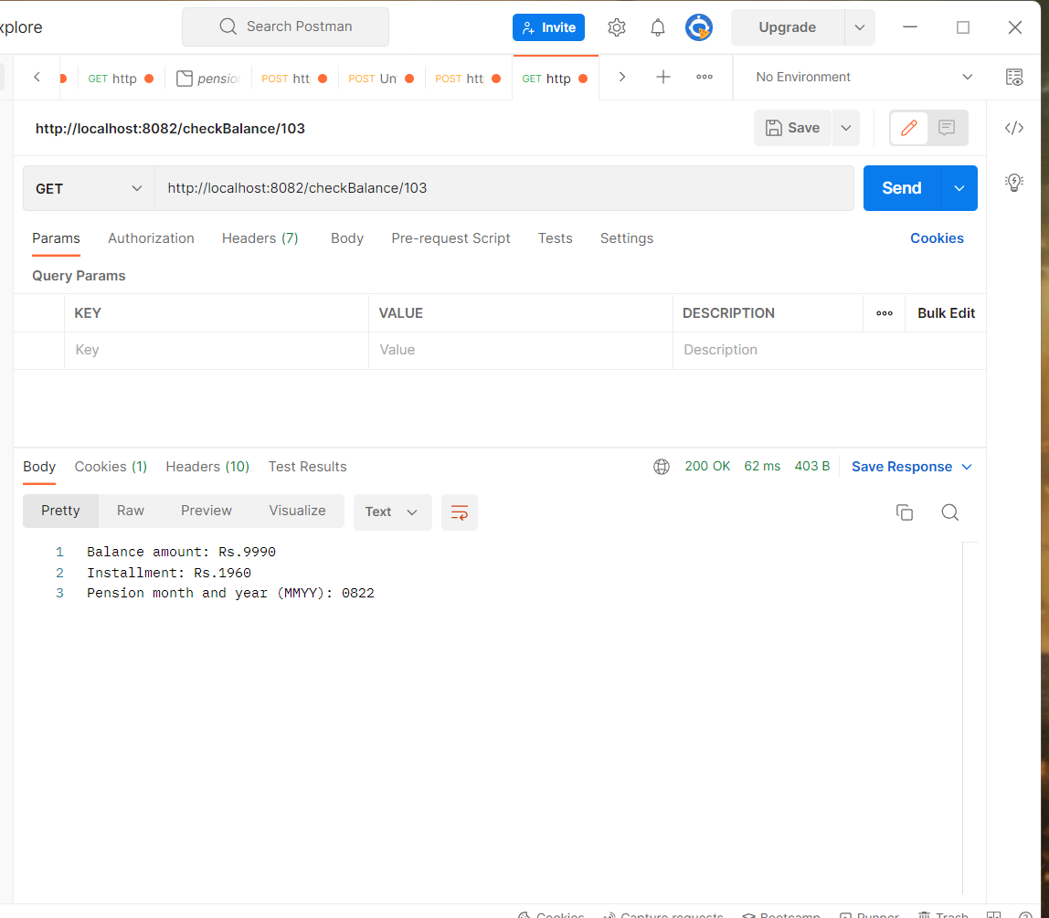
Check Balance:

Slide 14
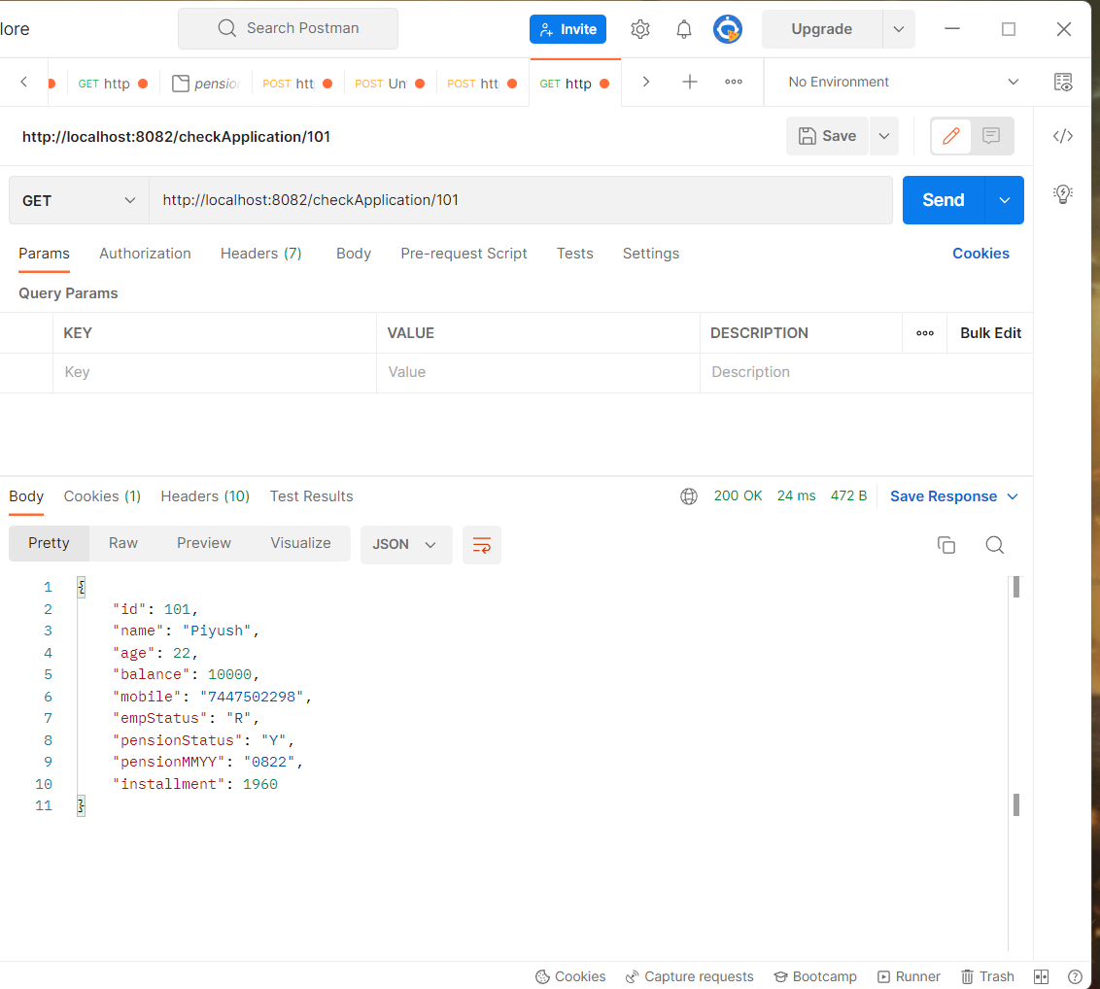
Check Applicant:

Slide 15
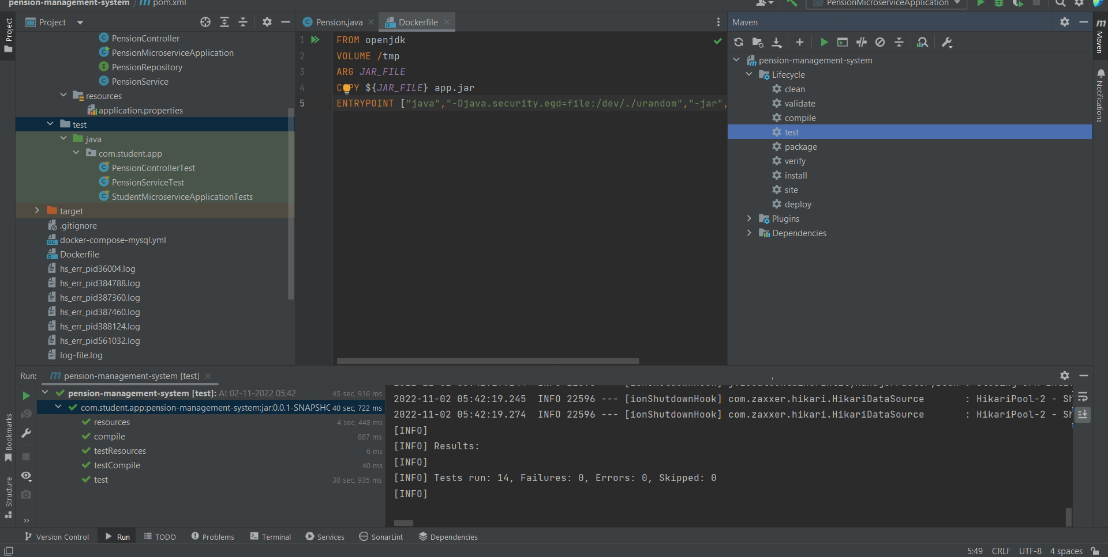
Test Cases:

Slide 16
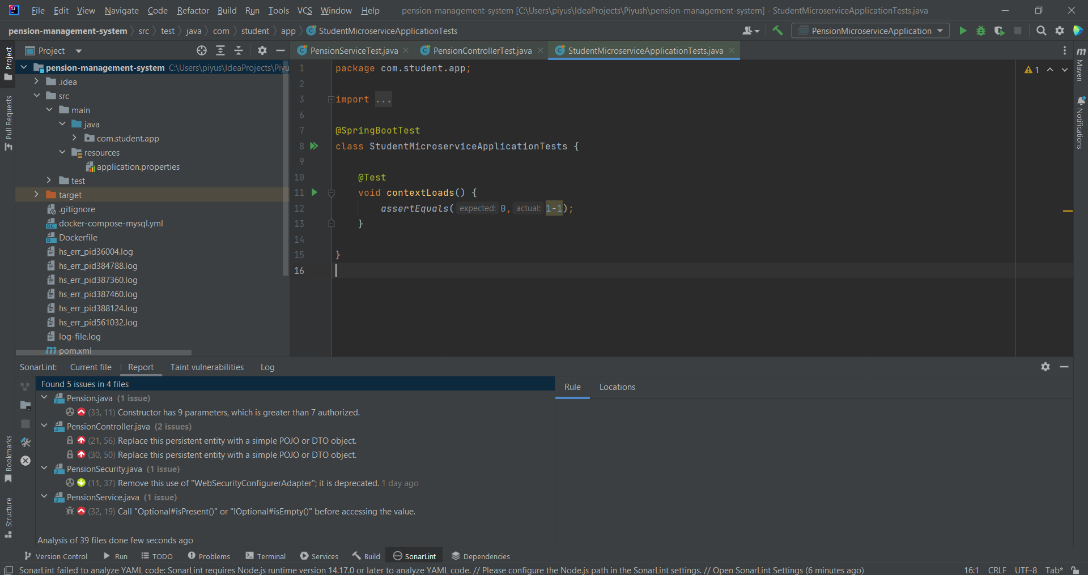
Sonarlist:

Slide 17
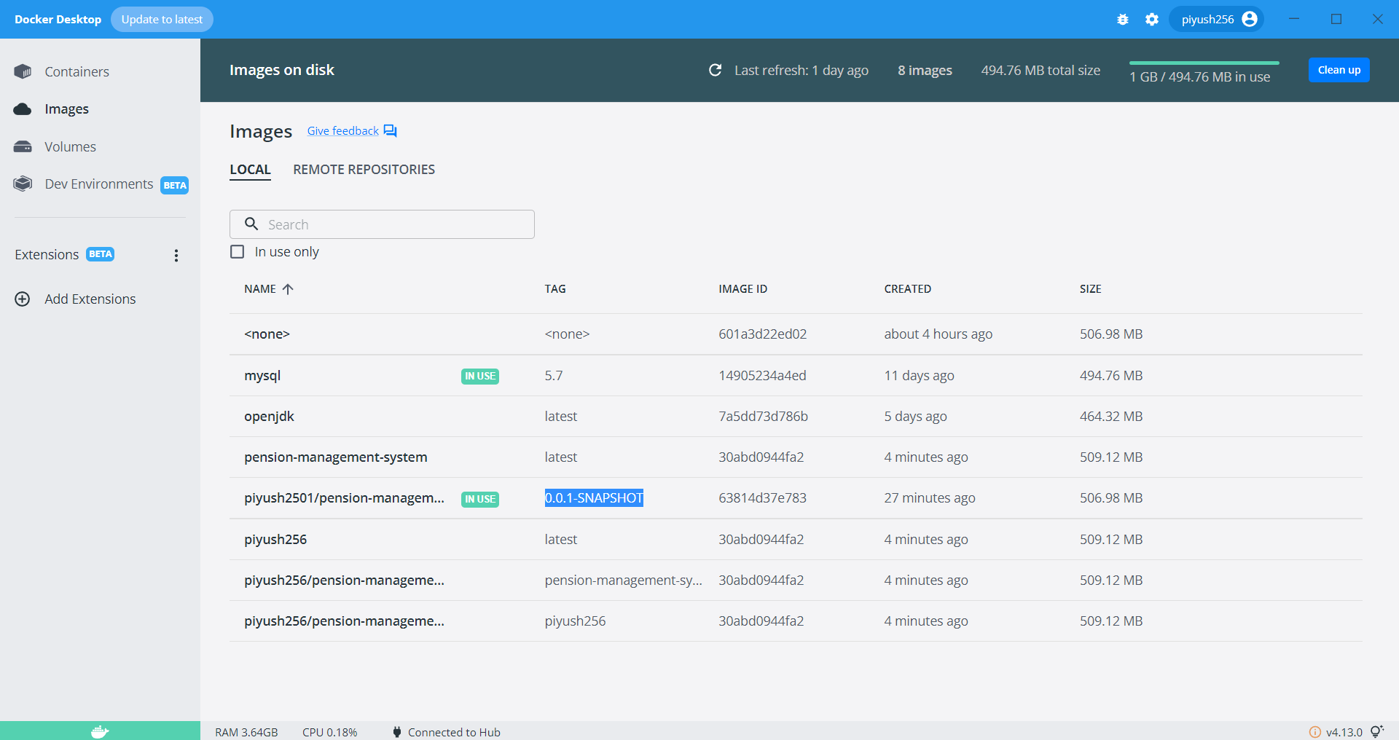
Docker:

Slide 18
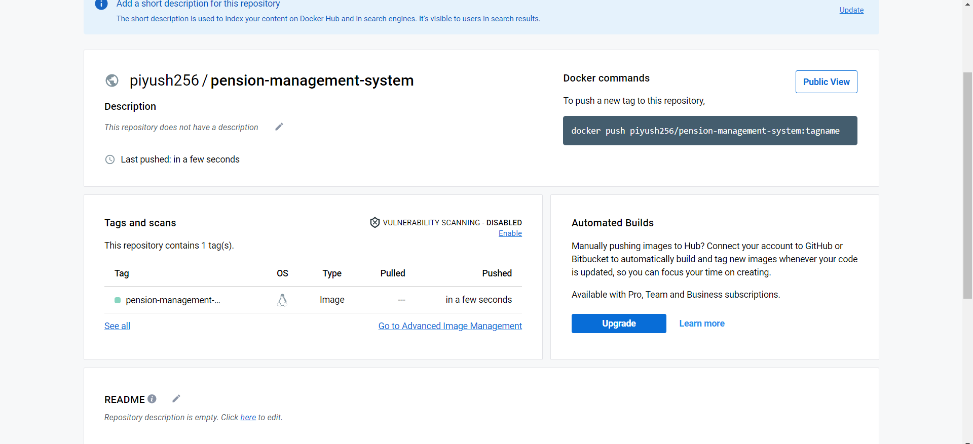
Docker HUB:

Slide 19
Conclusion:
REST API is simple and easy to use. Spring boot helps developer work faster then other software applications and by using microservice architecture improve performance, if developer want to change the code it can change easily. Each service is independent.

Slide 20
Thank You

